Slide 1
Substation and Distribution Automation
Module 10: Introduction to Micro-Grids

Slide 2
Module 10 Overview
Part 1: Micro-Grid Overview
Part 2: Micro-Grid Configurations
Part 3: Existing Micro-Girds
Part 4: Micro-Grid Control

Slide 3
Part 1: Micro-Grid Overview
Part 1: Micro-Grid Overview
Part 2: Micro-Grid Configurations
Part 3: …
Part 4: …

Slide 4
Recommended reading
N. Hatziargyriou et al, “Microgrids” IEEE Power & Energy Magazine, July/August 2007
J. Driesen et al, “Design for distributed energy resources,” IEEE Power & Energy Magazine, May/June 2008
B. Kroposki et al, “Making microgrids work,” IEEE Power & Energy Magazine, May/June 2008
F. Katiraei et al, “Microgrids management,” IEEE Power & Energy Magazine, May/June 2008
C. Marnay et al “Future Roles of Milli-, Micro-, and Nano- Grids,” CIGRÉ International Symposium, Bologna, Italy, September, 2011

Slide 5
Distributed energy resources (DER)
Microgrids are a framework to address the integration and control of distributed energy resources (DER)
DERs include:
Small (kW-scale) combined heat and power (CHP)
Distributed renewable generation: e.g. rooftop photovoltaic panes, small wind turbines, biogas digesters
Heat and electricity storage
Controllable loads (demand response): e.g. electric water heaters, HVAC, other controllable appliances

Slide 6
What are microgrids?
Definition of microgrid¹: Group of locally-controlled distributed energy resources (DER) connected to a low voltage (≈≤ 1 kV) or medium voltage (≈ 1 to 69 kV) distribution network.
Behaves as a single producer or load
Can operate in islanded mode
Small isolated power system also seen as microgrids
Microgrids that can separate from utility grid during disruption and continue to serve critical local load until grid service is restored (main objective of CERTS microgrid)
¹: N. Hatziargyriou et al, “Microgrids” IEEE Power & Energy Magazine, July/August 2007

Slide 7
Why microgrids?
Microgrids is a way to enable benefits of DERs:
Increase energy efficiency through combined heat and power (CHP)
Reduce carbon emissions
Increase local power quality and reliability
Reduced line losses
Transmission investment deferral
Reduce expensive fuel consumption in remote isolated microgrids
Challenge of controlling large number of DER can be addressed by microgrids. Microgrids coordinate DERs in a decentralized way reducing the control burden on the grid.
Enable provision of heterogeneous levels of power quality and reliability (PQR). For example, very high PQR provided to essential services like hospitals and communication equipment, while lower PQR provided to non essential loads like water pumps.

Slide 8
Consortium for Electricity Reliability Solutions (CERTS) Microgrids
Emphasis on microgrids that can separate from utility grid during disruption and continue to serve critical local load until grid service is restored
< 2MW peak sites,
No need of costly fast electrical controls
Droop controllers responding to local voltage and frequency
Single point of common coupling that does not export power (single controlled load)
No single device is essential (robust system)
Design to provide heterogeneous power quality and reliability. Sensitive loads served in island mode during disruption
Generic slow controls, e.g. economic dispatch

Slide 9
Future role of milligrids, microgrids, and nanogrids
Radical reorganization of parts of the distribution network and customer sites
New proposed entities: community grids or milligrids that operate a segment of the existing distribution system, microgrids which are akin to current customer sites but which have automonous control, and nanogrids, such as telecom or Ethernet networks that currently distribute power to many low-power devices (typically DC with high power quality and reliability).
Local heterogeneous power quality and reliability (PQR) becomes a possibility
C. Marnay et al “Future Roles of Milli-, Micro-, and Nano- Grids,” CIGRÉ International Symposium, Bologna, Italy, September, 2011

Slide 10
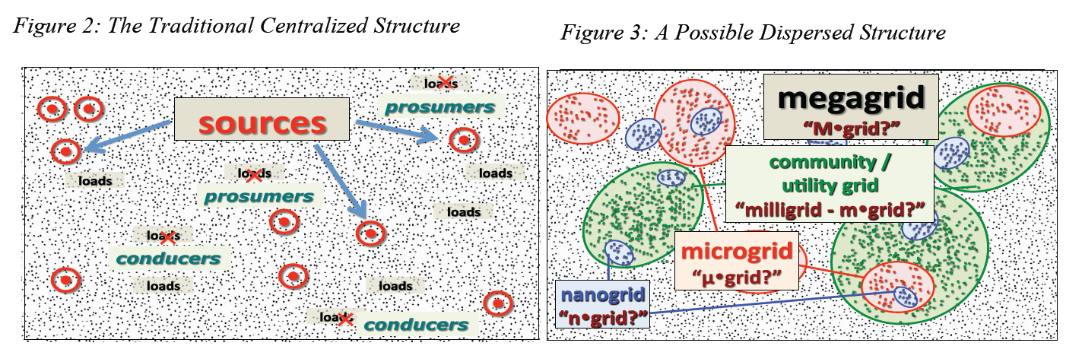
Milligrids, microgrids, and nanogrids
Few large generators
With distributed generation, some small consumers could become producers at some moments (prosumers)
Highly centralized control (traditional paradigm)
Microgrids (or customer microgrid): Independent control nodes. One meter, and one or few points of interconnections
Milligrids (utility microgrid): Sections of distribution network including generation and loads. Public utility regulation
Nanogrids: Low energy grids, typically DC, designed to deliver high PQR
C. Marnay et al “Future Roles of Milli-, Micro-, and Nano- Grids,” CIGRÉ International Symposium, Bologna, Italy, September, 2011

Slide 11
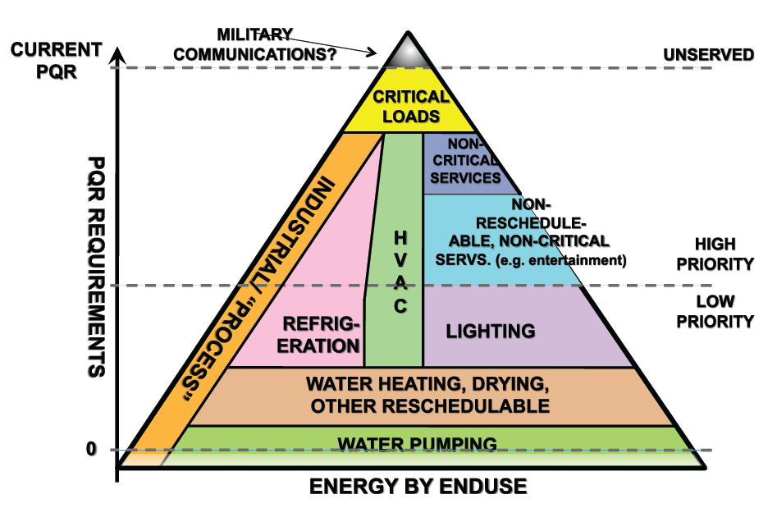
Enabling heterogeneous power quality and reliability
C. Marnay et al “Future Roles of Milli-, Micro-, and Nano- Grids,” CIGRÉ International Symposium, Bologna, Italy, September, 2011

Slide 12
Classification of microgrids
Utility Microgrids: Urban and rural
Objectives: Outage management and renewable integration
Transition to grid independent or isolated operation: faults, maintenance
Industrial/commercial microgrids: multi- and single-facility
Objectives: Power quality, reliability and efficiency
Transition to grid independent or isolated operation: faults, power quality, energy price, maintenance
Remote microgrids
Objectives: Electrification of remote areas, reduce fuel consumption through renewable integration

Slide 13
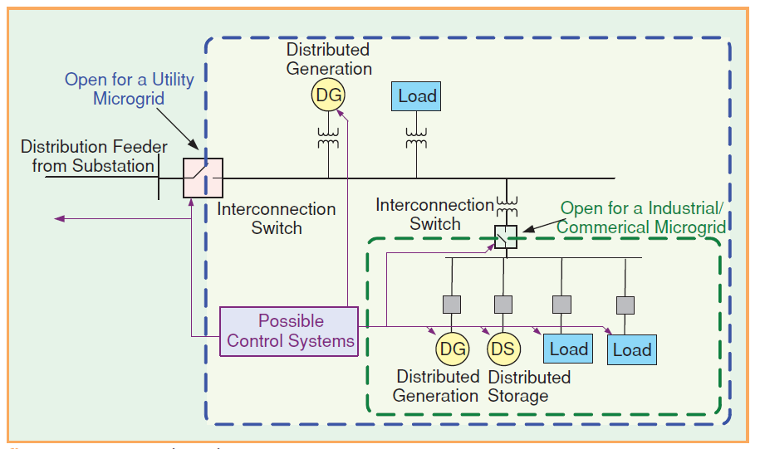
Microgrid components
B. Kroposki et al, “Making microgrids work,” IEEE Power & Energy Magazine, May/June 2008

Slide 14
Distributed generation
Combined heat and power systems
Photovoltaic generators
Wind turbines
Microturbines
Fuel cells

Slide 15
Distributed Storage
Community storage (e.g. batteries, flywheels)
Thermal storage

Slide 16
Demand response
Sensitivity to electricity price
Grid support for stressed condition

Slide 17
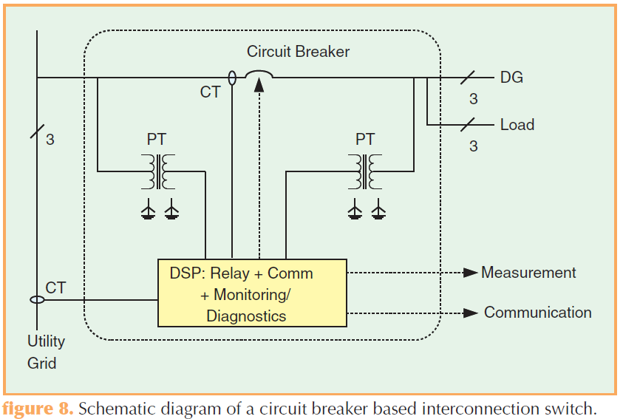
Interconnection switch
Consolidated power switching protective relay metering and communications
Either circuit breaker or semiconductor-based static switches
B. Kroposki et al, “Making microgrids work,” IEEE Power & Energy Magazine, May/June 2008

Slide 18
Part 2: Micro-Grid Configurations
Part 1: Micro-Grid Overview
Part 2: Micro-Grid Configurations
Part 3: …
Part 4: …

Slide 19
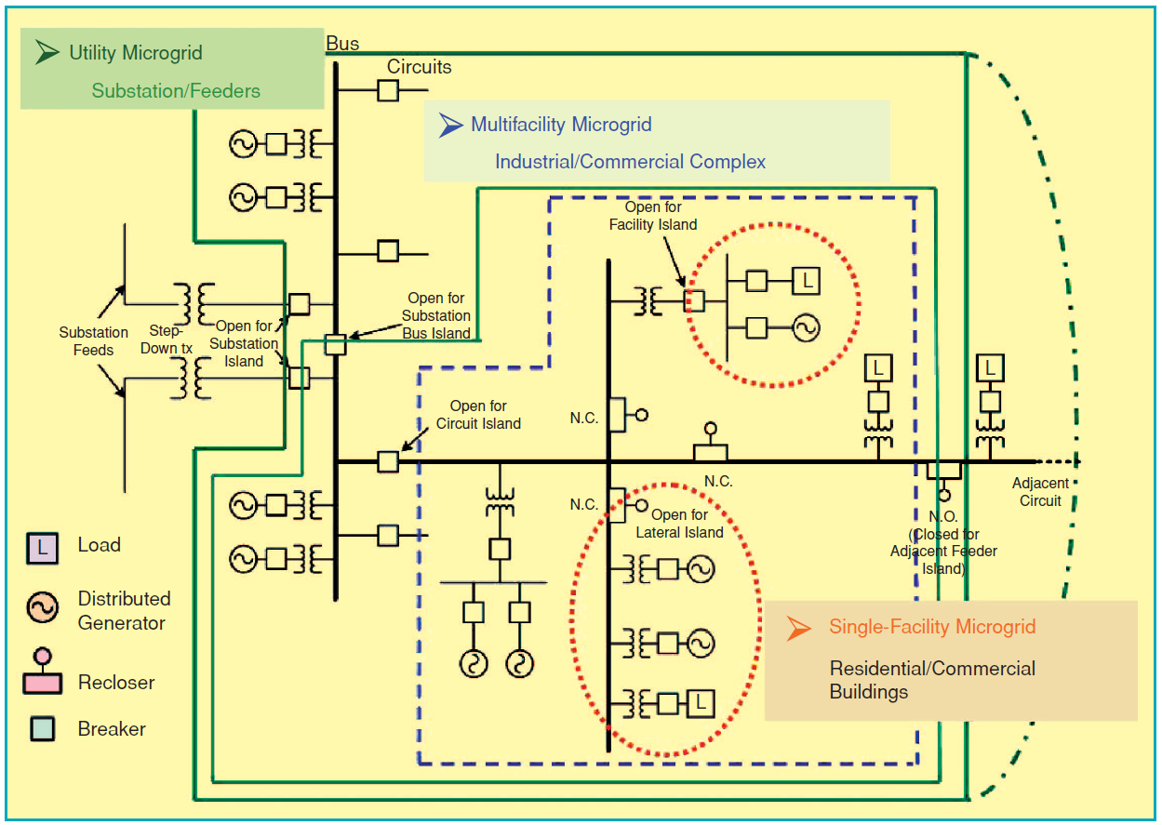
Typical topologies
J. Driesen et al, “Design for distributed energy resources,” IEEE Power & Energy Magazine, May/June 2008

Slide 20
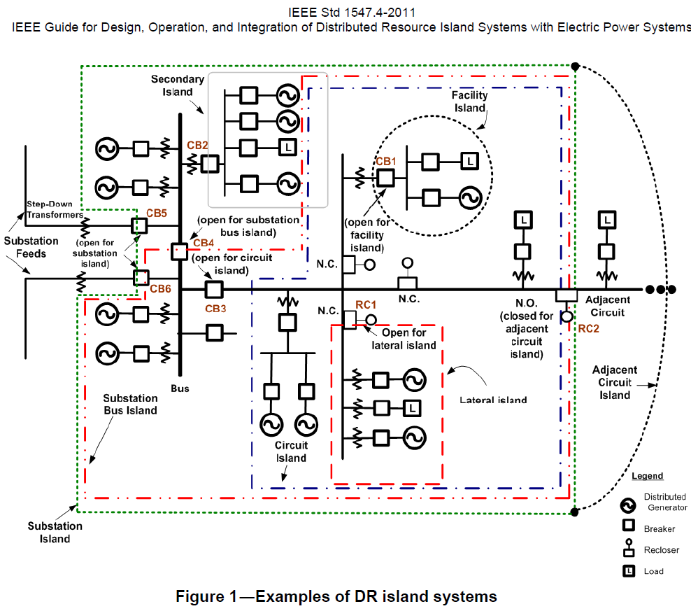
Microgrids typical topologies

Slide 21
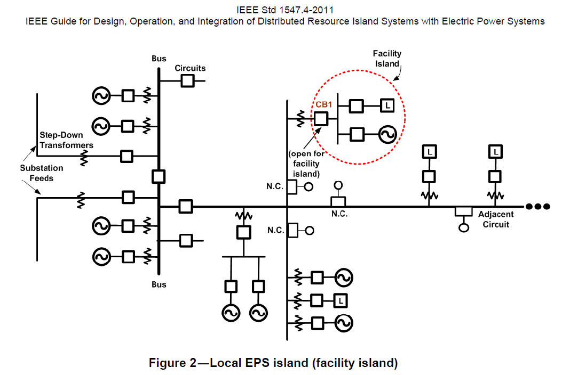
Local electric power system (EPS) island

Slide 22
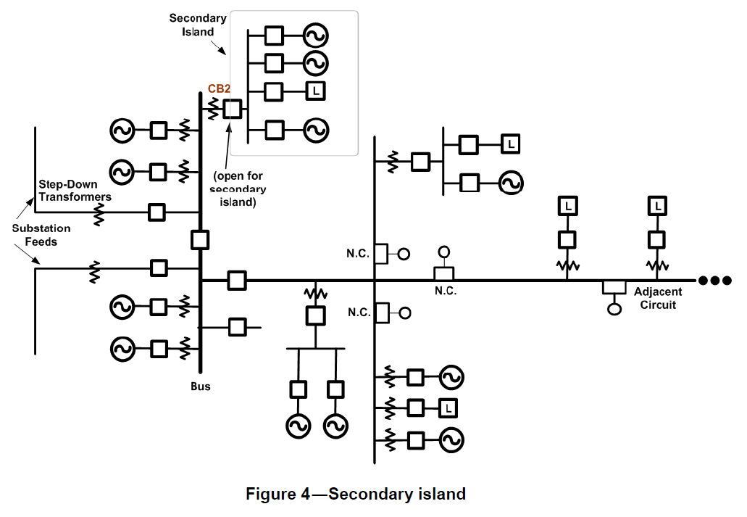
Secondary island

Slide 23
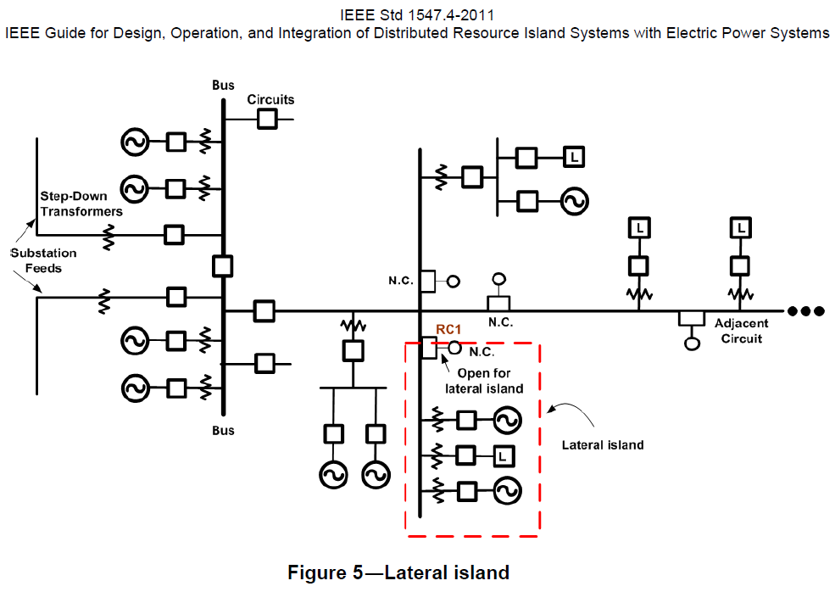
Lateral island

Slide 24
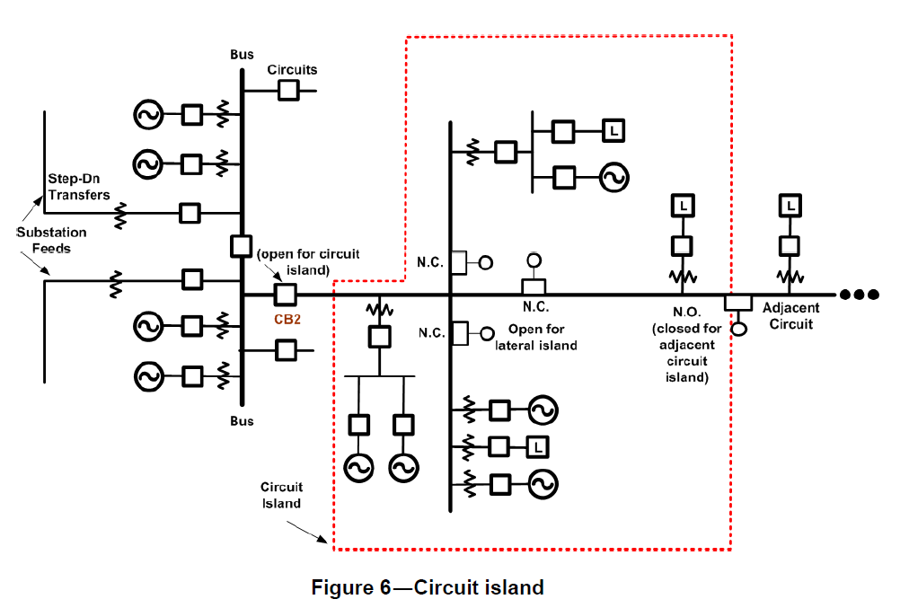
Circuit island

Slide 25
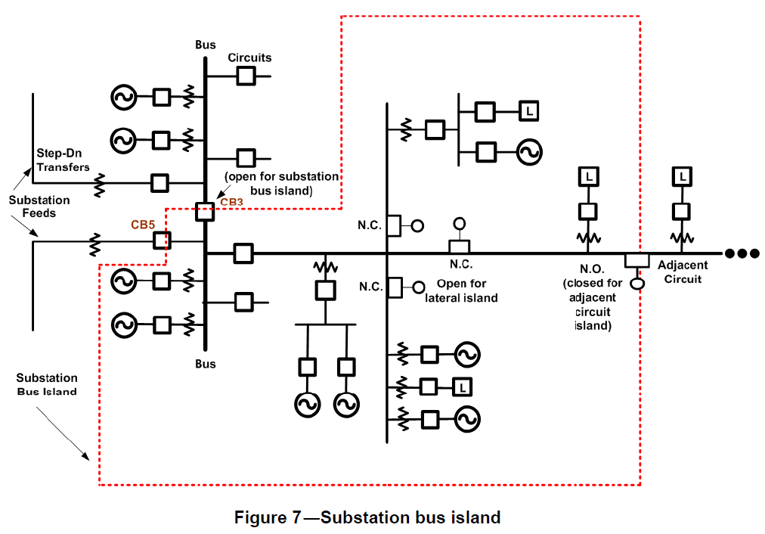
Substation bus island

Slide 26
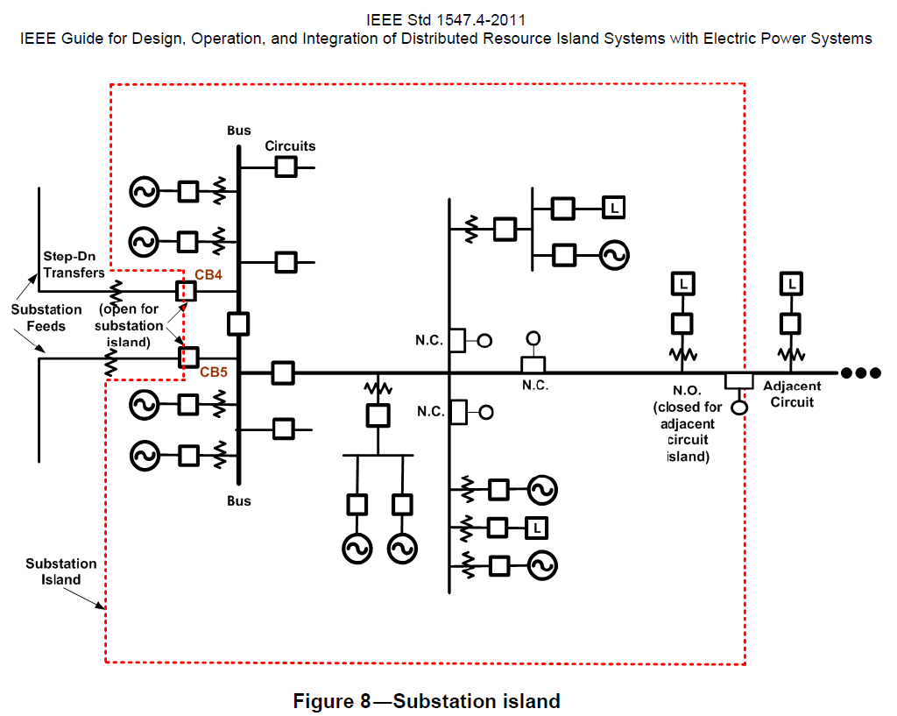
Substation island

Slide 27
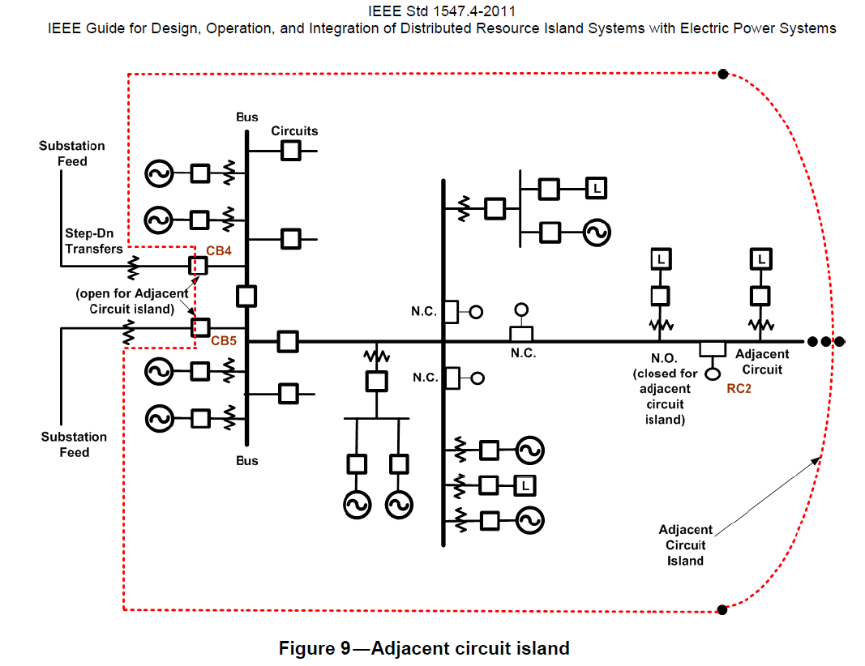
Adjacent circuit island

Slide 28
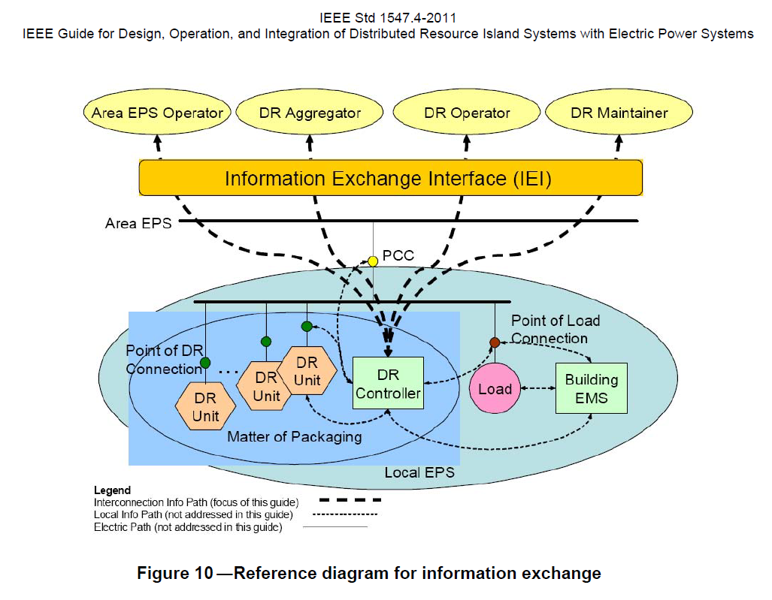
Information exchange

Slide 29
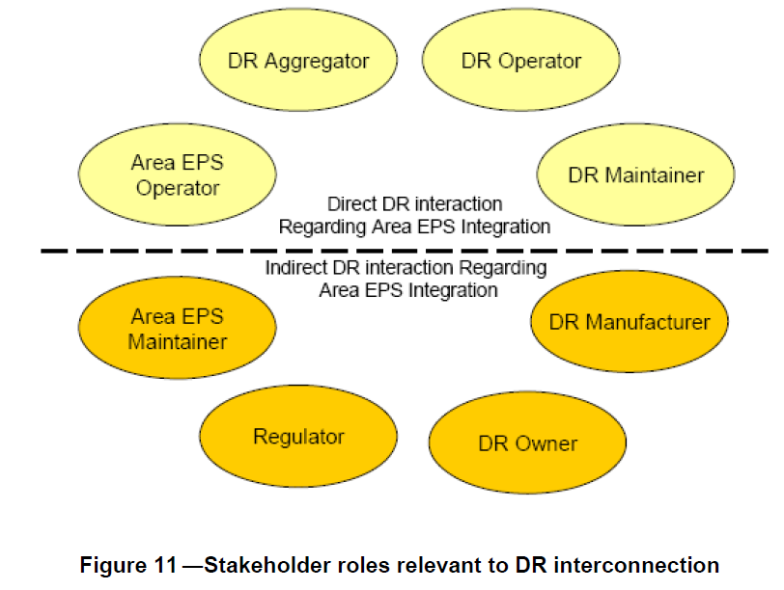
Stakeholders

Slide 30
Part 3: Existing Micro-Girds
United States
Europe
Japan
Canada

Slide 31
US Micro-Grids
Dolan technology center (Ohio)
GE global research microgrid: microgrid energy management (demonstration to end in 2008?)
Perfect power at the Illinois Institute of Technology
Military bases: Twenty-nine Palms Microgrid (GE), Fort Bragg

Slide 32
European Micro-Grids
Kythnos island (Greece)
Continuon’s MV/LV facility (Netherlands)
MVV Residential demonstration (Germany)

Slide 33
Japanese Micro-Grids
Aomori (PV, WT, and biogas, biomass, provide electricity and heat, lead acid battery, )
Aichi (fuel cells, biogas, PV, NaS battery, islanding tests)
Kyoto (PV, WT, biogas, fuel cells, battery)
Sendai (demonstrate multiple PQR levels)
Private sector: Shimizu Corporation, Tokyo Gas

Slide 34
Canadian Micro-Grids
Autonomous remote microgrids: Ramea (wind-diesel, 1.2MW peak load, 395kW wind)
Grid connected: Fortis-Alberta (hydro-wind)
Planned microgrid islanding: BC Hydro Boston Bar (3MW peak load, 8.64MW run-of-river hydro), Hydro Quebec (15MW load, 31MW steam)

Slide 35
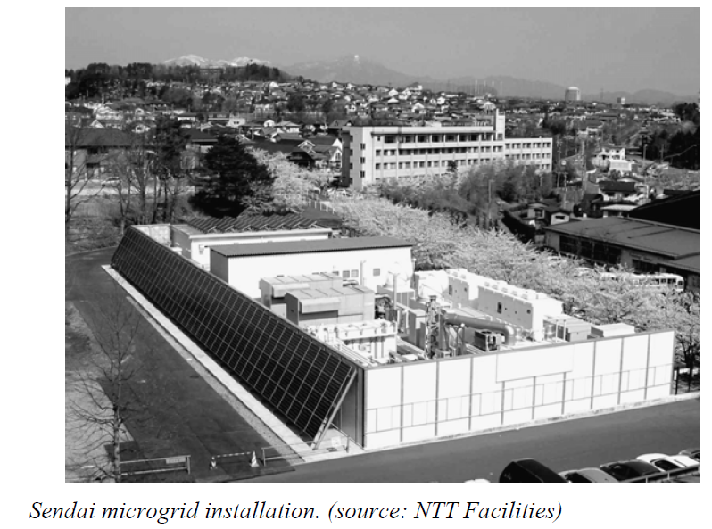
Sendai, Japan Microgrid
DC loads served directly on a circuit dedicated to critical telecommunications equipment
Multiple qualities of AC services:
medical school
high school
water treatment plant

Slide 36
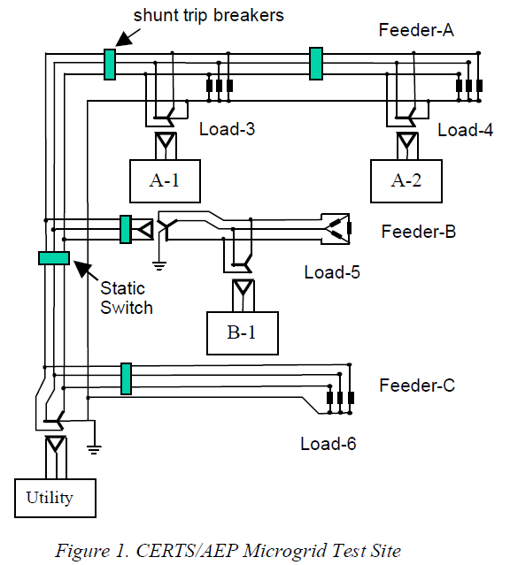
AEP / CERTS microgrid test bed
Tested islanding and resynchronization
Electrical protection system distinguished between normal and faulted operation
Controls robust under motor starts and high impedance faults.
R. H. Lasseter et al, “CERTS Microgrid Laboratory Test Bed,” Submitted to IEEE Transactions on Power Delivery, 2010

Slide 37
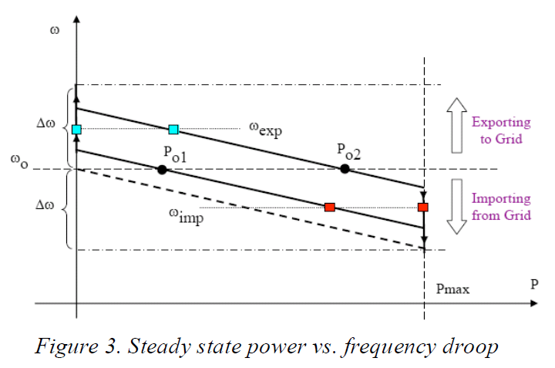
AEP / CERTS microgrid test bed

Slide 38
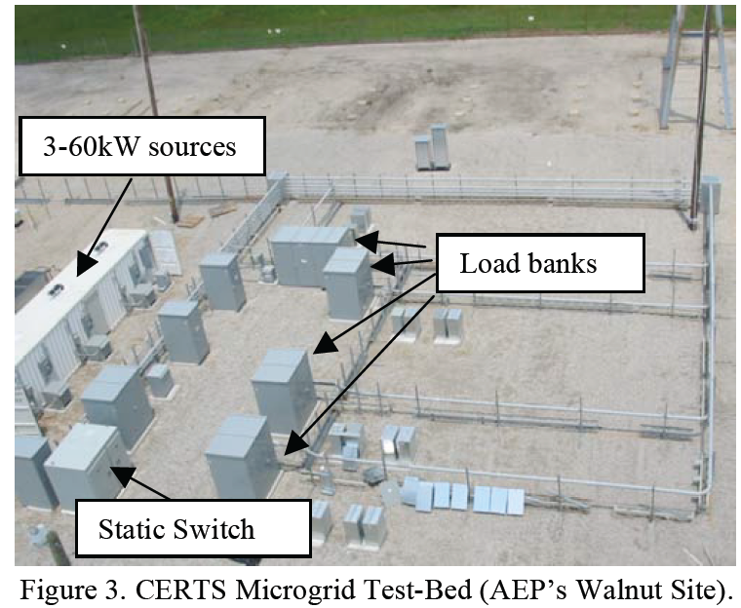
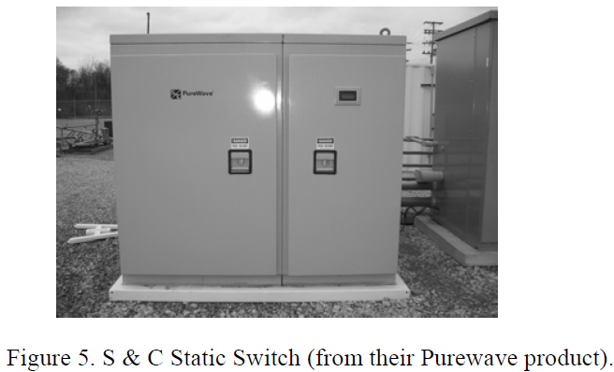
AEP / CERTS microgrid test bed
J. Eto et al, “CERTS Micorgrid Laboratory Test Bed,” California Energy Commission, Public Interest Energy Research Program. CEC-500-2008-XXX

Slide 39
Existing microgrid implementations
USA:
AEP / CERTS microgrid test bed
Perfect power at the Illinois Institute of Technology
Santa Rita Jail, California

Slide 40
AEP / CERTS microgrid test bed
Tested islanding and resynchronization
Electrical protection system distinguished between normal and faulted operation
Controls robust under motor starts and high impedance faults.
R. H. Lasseter et al, “CERTS Microgrid Laboratory Test Bed,” Submitted to IEEE Transactions on Power Delivery, 2010

Slide 41
AEP / CERTS microgrid test bed

Slide 42
AEP / CERTS microgrid test bed
J. Eto et al, “CERTS Micorgrid Laboratory Test Bed,” California Energy Commission, Public Interest Energy Research Program. CEC-500-2008-XXX

Slide 43
AEP / CERTS microgrid test bed
J. Eto et al, “CERTS Micorgrid Laboratory Test Bed,” California Energy Commission, Public Interest Energy Research Program. CEC-500-2008-XXX

Slide 44
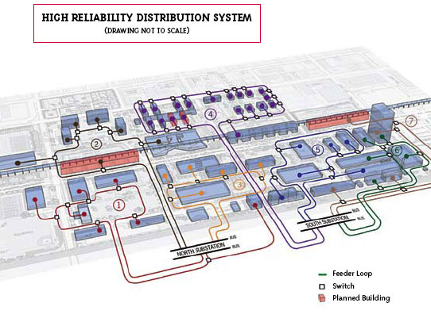
Illinois Institute of Technology, USA
Seven loops (colored lines)
Switches (small white boxes) to control the flow of electricity
In case of outage, Switches will automatically reroute power ensuring power delivery to other buildings
IIT engineers will be able to find the cause of the outage immediately and restore power much more quickly
http://www.iit.edu/perfect_power/

Slide 45
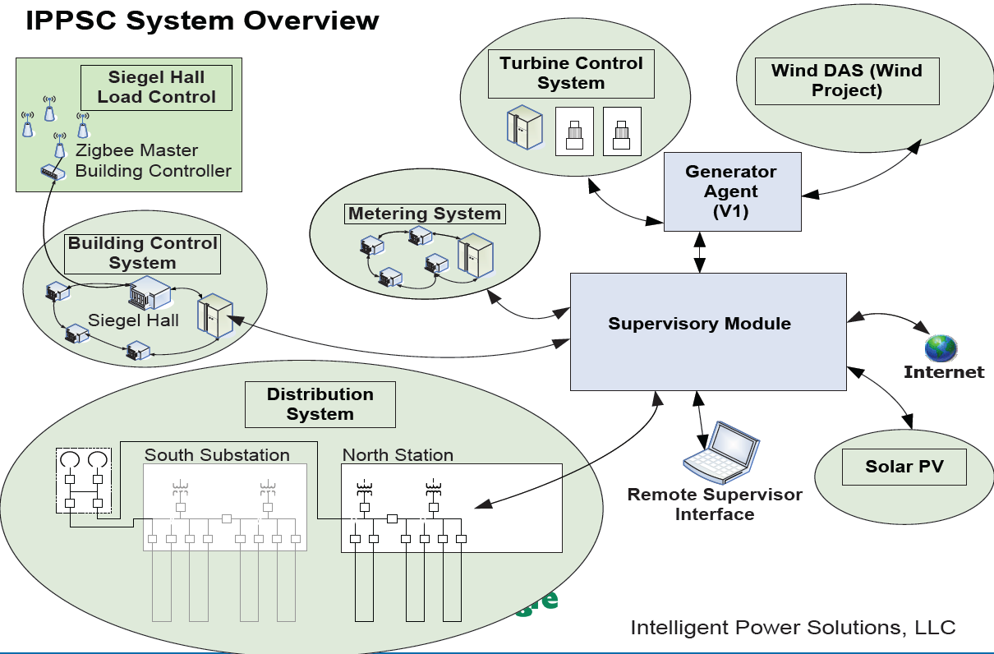
Illinois Institute of Technology, USA
50% peak demand reductuib
20% permanent demand reduction
Cost avoidance and savings in outage cost
Deferral of planned substations
M. Shahidehpour, “Microgrid – a new hub in energy infrastructure,” Cigre 2011 Bologna Symposium, September 2011

Slide 46
Santa Rita Jail, California
1.2 MW rooftop photovoltaic system installed in 2001
1 MW molten carbonate fuel cell installed in 2006. Combined heat and power (CHP) operation
Peak demand in the jail is approximately 3 MW.
Proposed addition:
2 MW / 12 MWh of NaS batteries
wind capacity
concentrating solar thermal system
C. Marnay et al, “A Green Prison: Santa Rita Jail Creeps Towards Zero Net Energy (ZNE),” ECEEE 2011 Summer Study France, June 2011

Slide 47
Existing microgrid implementations (…cont’d 1)
Europe:
Lab microgrid at NTUA, Greece
Kythnos island, Greece
MVV Energie Residential demonstration , Germany
Bronsbergen Holiday Park, Netherlands

Slide 48
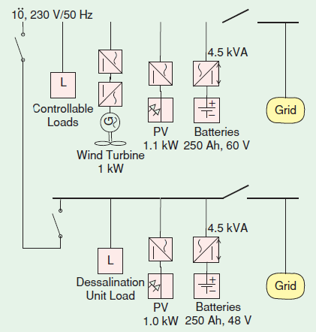
Lab microgrid at NTUA, Greece
To test small-scale equipment and control strategies for microgrids
2 buses, grid connected or isolated
Batteries provide frequency and voltage regulation in island mode
Multi-agent control implemented for sources and loads
B. Kroposki et al, “Making microgrids work,” IEEE Power & Energy Magazine, May/June 2008

Slide 49
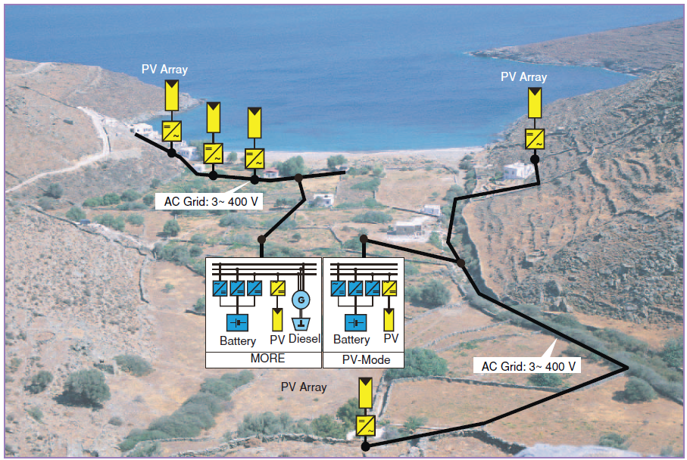
Kythnos island, Greece
Microgrid central controller development
N. Hatziargyriou et al, “Microgrids” IEEE Power & Energy Magazine, July/August 2007

Slide 50
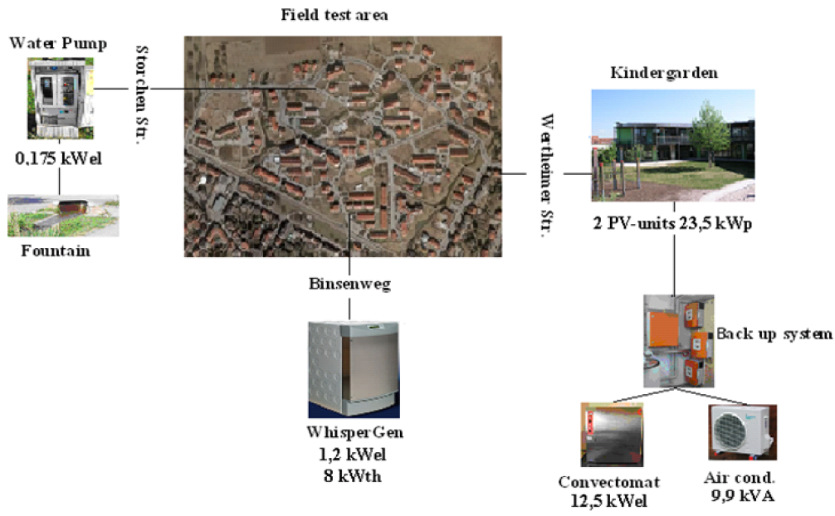
MVV Energie, Germany
580 households, PV systems, CHP
Intermeshed ring grid structure connected to 3 transformers
Encouraged customers to shift loads to high solar generation periods
Field test on the transfer between interconnected and islanding mode
Evaluate agent based decentralized control
“Deliverable DF5: Report on Field Test for the Transfer between Interconnected and Islanding Mode at the Ecological Settlement in Mannheim-Wallstadt (MVV),” More Microgrids, December 2009

Slide 51
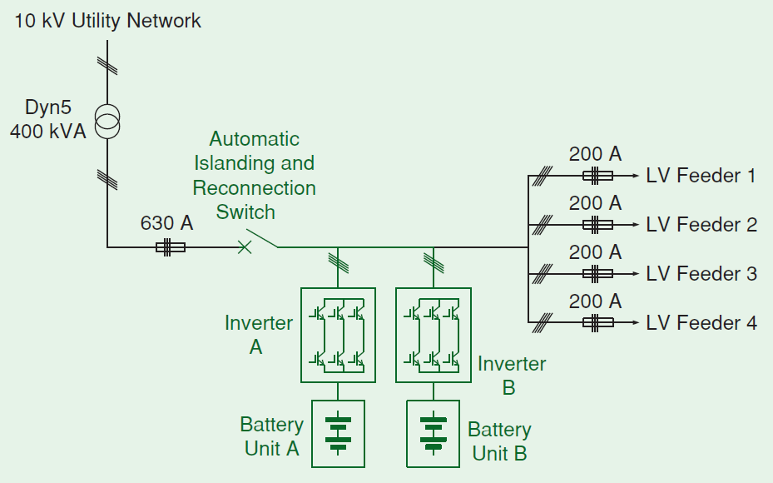
Bronsbergen Holiday Park, the Netherlands
210 cottages, 108 with PV systems, peak load is ~ 90 kW, installed PV power is 315 kW
Three-phase 400-V network, connected to a 10-kV medium-voltage network
Experimental validation of islanded operation by storage
Evaluation of islanded operation, automatic isolation and reconnection, fault level, harmonic voltage distortion, energy management and storage lifetime optimization, and converters parallel operation
B. Kroposki et al, “Making microgrids work,” IEEE Power & Energy Magazine, May/June 2008

Slide 52
Existing microgrid implementations (…cont’d 2)
Japan (motivated by compensation of local variability and present itself as constant load to the grid):
Aichi (fuel cells, biogas, PV, NaS battery, islanding tests)
Hachinohe
CRIEPI
Sendai (demonstrate multiple PQR levels)

Slide 53
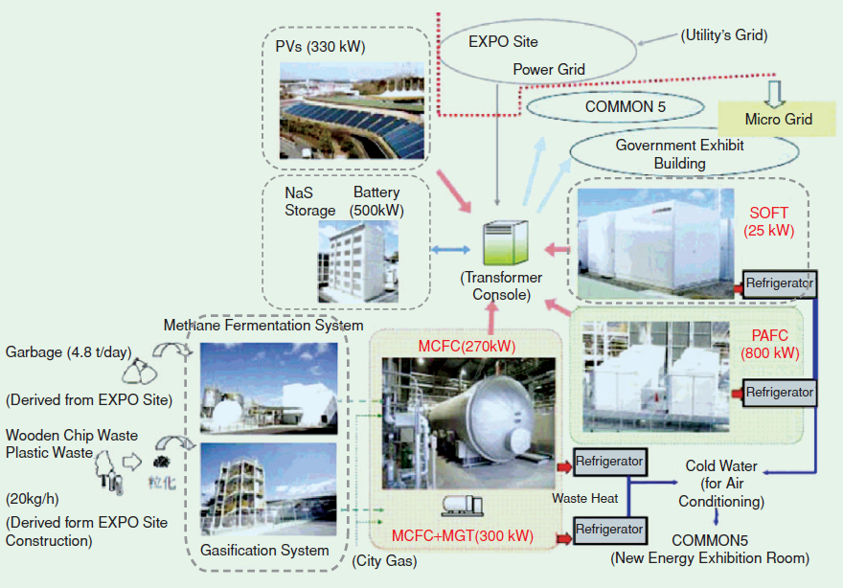
Aichi Microgrid, Japan
Control systems for matching energy demand and supply for microgrid operation
Fuel cells, PV, and NaS battery
Load-generation balancing was maintained at 3% for as short as 10-minute intervals
B. Kroposki et al, “Making microgrids work,” IEEE Power & Energy Magazine, May/June 2008

Slide 54
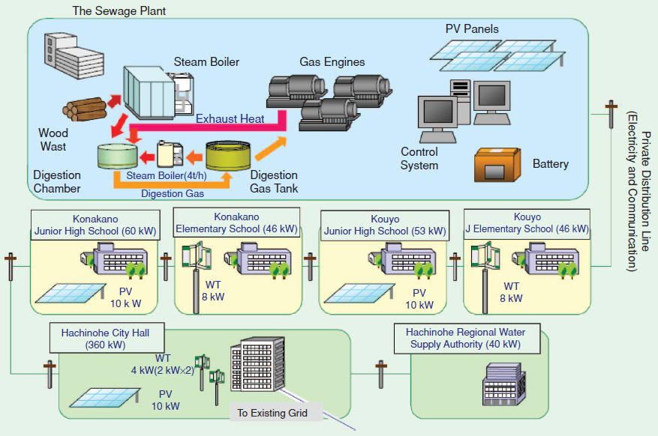
Hachinohe microgrid, Japan
> 5km distribution line
Gas, PV, and wind generation
Weekly supply and demand planning, economic dispatch control every 3 minutes, and second-by-second power flow control at interconnection
3% balancing error during 99.99% of the system’s operational time
Grid isolated operation
B. Kroposki et al, “Making microgrids work,” IEEE Power & Energy Magazine, May/June 2008

Slide 55
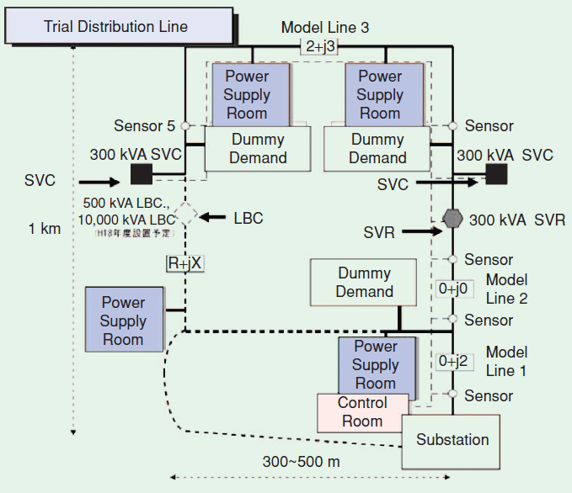
CRIEPI, Japan
Static var compensator (SVC), a step voltage regulator (SVR), and loop balance controllers (LBCs)
LBCs can control power flow between two distribution feeders by back-to-back (BTB) type converter.
The LBCs allow connections of two sources with different voltages, frequencies, and phase angles by providing a dc link
B. Kroposki et al, “Making microgrids work,” IEEE Power & Energy Magazine, May/June 2008

Slide 56
Sendai, Japan
DC loads served directly on a circuit dedicated to critical telecommunications equipment
Multiple qualities of AC services:
medical school
high school
water treatment plant

Slide 57
Existing microgrid implementations (…cont’d 2)
Canada
Fortis-Alberta (hydro-wind)
BC Hydro Boston Bar (3MW peak load, 8.64MW run-of-river hydro),
Hydro Quebec (15MW load, 31MW steam)

Slide 58
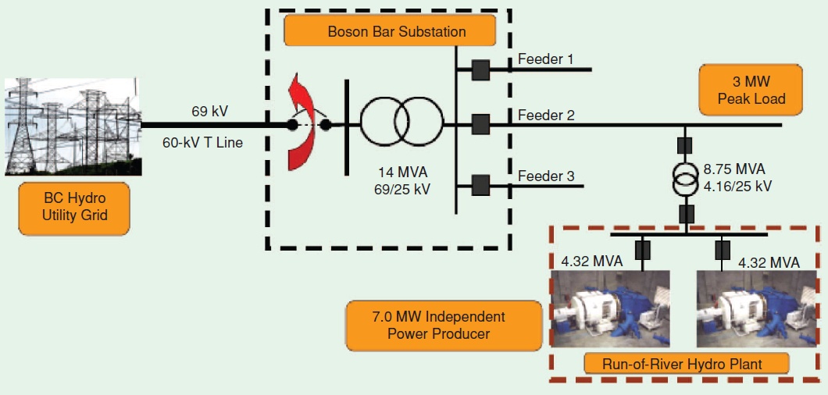
Boston Bar IPP and BC Hydro, Canada
To reduce sustained power-outage durations
Local IPP to operate in island mode
Two 3.45-MW hydro generators, connected to feeder with peak load of 3.0 MW
B. Kroposki et al, “Making microgrids work,” IEEE Power & Energy Magazine, May/June 2008

Slide 59
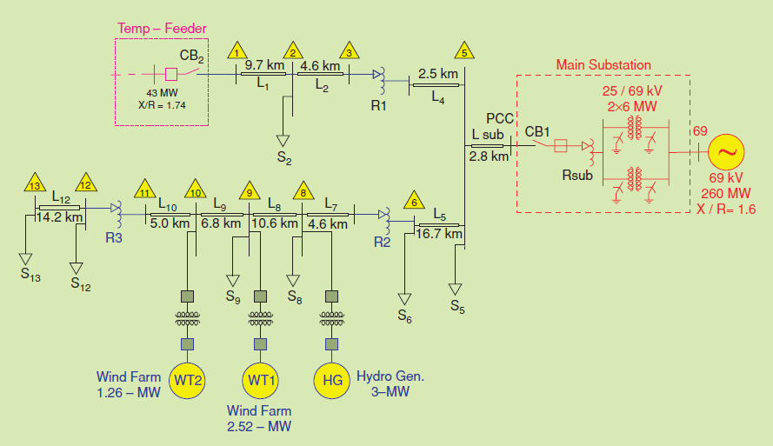
Fortis-Alberta, Canada
Identified as a grid-tied microgrid.
25-kV distribution network, supplied by 65-kV/25-kV substation
“Temp-feeder” to supply power (from a 138-kV/25-kV substation) during main substation maintenance
Isolated operation challenged by wind variability and hydro insufficient ramp rate
N. Hatziargyriou et al, “Microgrids” IEEE Power & Energy Magazine, July/August 2007

Slide 60
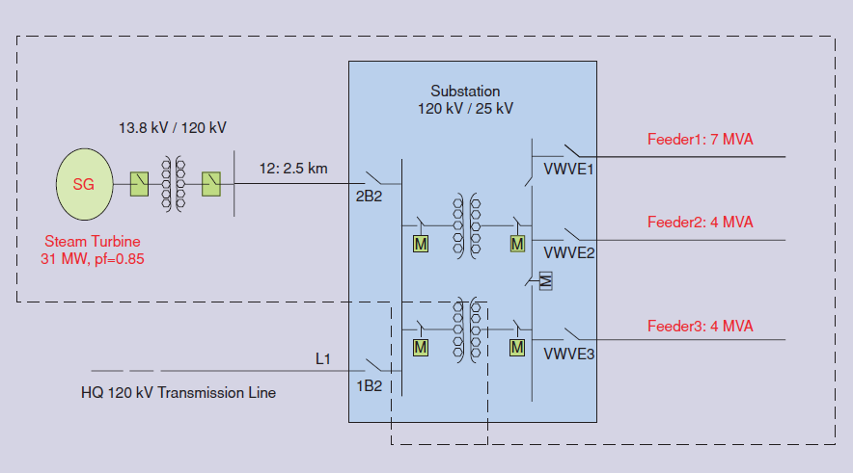
Hydro-Quebec, Canada
Islanded operation tests. 10MW were successfully supplied
N. Hatziargyriou et al, “Microgrids” IEEE Power & Energy Magazine, July/August 2007

Slide 61
Part 4: Micro-Grid Control
Part 1: Micro-Grid Overview
Part 2: Micro-Grid Configurations
Part 3: …
Part 4: …

Slide 62
Micro-Grid Control Issues
In an interconnected power system frequency is maintained by the large central generation units.
At the distribution feeder level the substation transformer provides what appears to be an infinite or stiff bus.
Frequency is independent of the load at a single feeder.
Voltage is controlled by a combination of central generating units and distributed voltage control devices. Since reactive power can not be effectively transferred long distances, voltage control is generally a local operation.
In a micro-grid, there is no stiff bus and the individual generators must operate together.
Changes in load can cause significant changes in frequency.
The lack of a central control can cause inter machine oscillations.
In a micro-grid, voltage is controlled by the local generation and other voltage control devices.
There are multiple control strategies for micro-grids:
Central
Hierarchical
Decentralized

Slide 63
Basic Physics of Micro-Grid Stability
Frequency Control
Voltage Control
Frequency is determined by the speed of rotating machines or the output of inverters.
In a micro-grid the system is not supported by large central generators with large inertial masses.
The classical swing equation can be used to determine the frequency in a system.
Voltage is generally a local effect and as such is more easily controlled on a micro-grid.
It is controlled by the generators and other voltage control devices.
Voltage control is a mid-term dynamics problem.

Slide 64
Frequency Control
In an interconnected power system the frequency is determined by the speed of the generators. At nominal speed the generators produces 60 Hz.
There is only a single value of frequency in an interconnected power system, with all generators operating in synchronism.
These same basic principles apply to a micro-gird, it is only the characteristics and controls that change.
The machines on a micro-grid are significantly smaller, with the largest load sometimes the size of a single generator.
In general, the machines on a micro-grid do not have all of the control features of a large central plant machine.

Slide 65
Physical Interpretation of the Swing Equation

Slide 66
The Swing Equation
The swing equation is generated using Newton's Second Law with the acceleration equal to the difference in electrical and mechanical toque.
The swing equation does not deal with rectilinear motion, instead the motion is rotational.
H is a measure of the stored rotational kinetic energy of a machine divided by the VA base.
J is the moment of inertia for a rotating body has a well defined form.

Slide 67
The Swing Equation
The moment of inertia for the rotational mass is expressed as a function of the inertia constant.
The moment of inertia is then substituted back into the equation for Newton’s Second Law.
The base torque is then defined based on the base VA and base angular velocity.
Using the base torque the equation is converted to a per unit system.

Slide 68
The Swing Equation
The derived equation does not account for any friction or losses in the system
This results in a model that has no damping
It is common to add a term to the swing equation in order to generate a component of damping torque
This final equation is the classical swing equation

Slide 69
Representation of the Swing Equation
The swing equation has been expressed as a second order differential equation
For the purpose of numeric simulation the second order differential equation can be expressed in 2 possible forms:
Transfer Function
State Space Representation

Slide 70
Representation of the Swing Equation
In order to represent the swing equation in the state space it is necessary to express it as 2 coupled first order ODEs

Slide 71
Transfer Function Representation of the Swing Equation Single Machine Infinite Bus (SMIB)

Slide 72
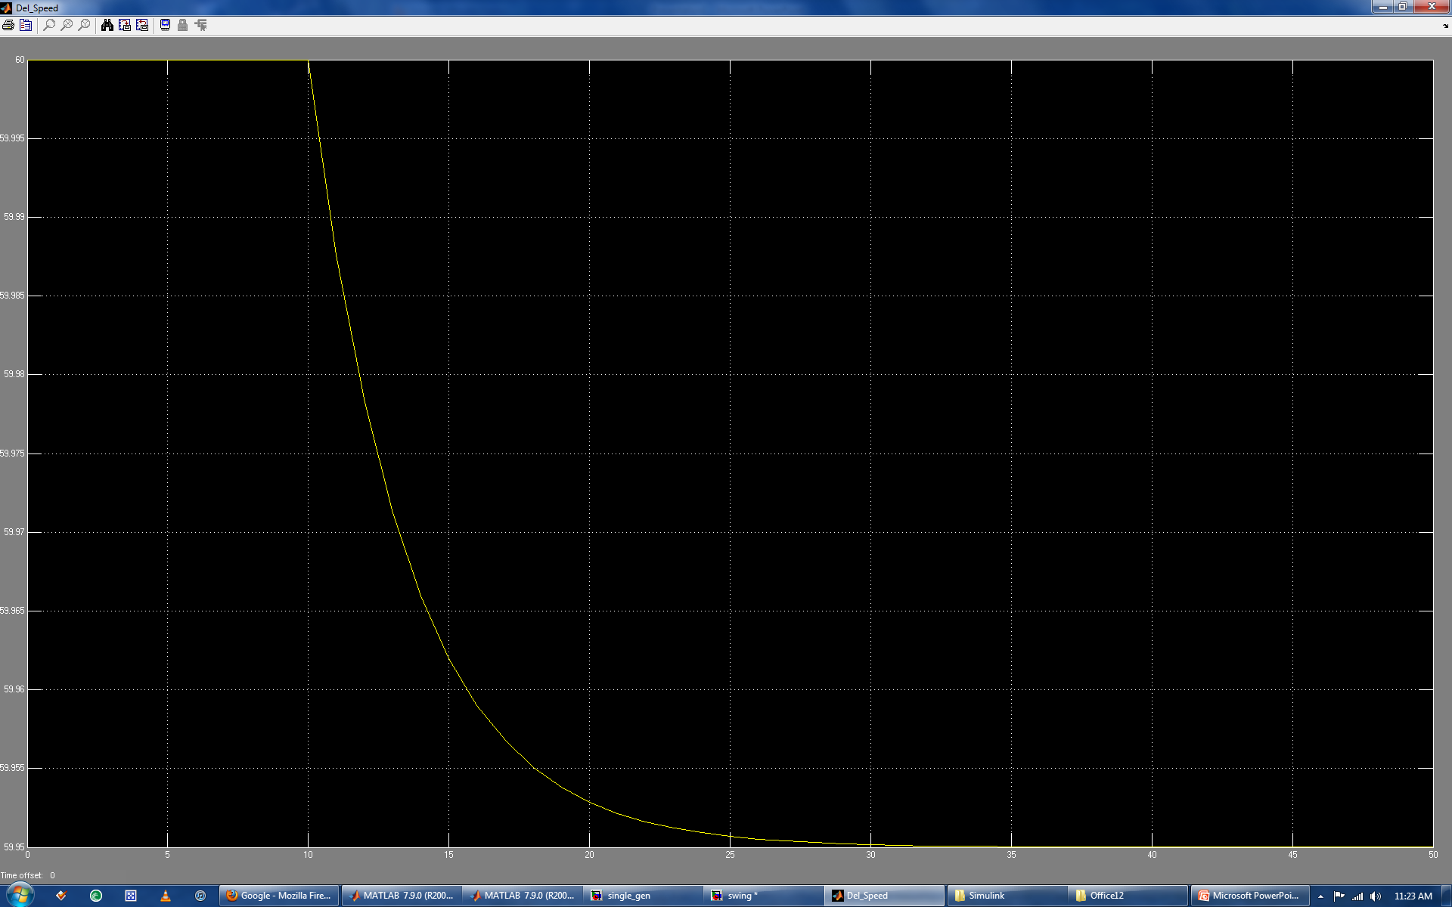
SMIB Frequency Response to Load Change
The classical representation of a generator is a simple rotating mass.
As a result, there are no control devices to bring the frequency back to nominal after the change in load.
While the SMIB model forms a basis for analysis, more complicated models are necessary.

Slide 73
Transfer Function Representation of the Swing Equation
The swing equation only accounts for the behavior of a rotating mass, there are many other components to a generator.
Sub-transient model
Transient mode
Governor
Voltage regulator
Power System Stabilizer (PSS)
Each of these elements adds to the complexity of the generator representation.

Slide 74
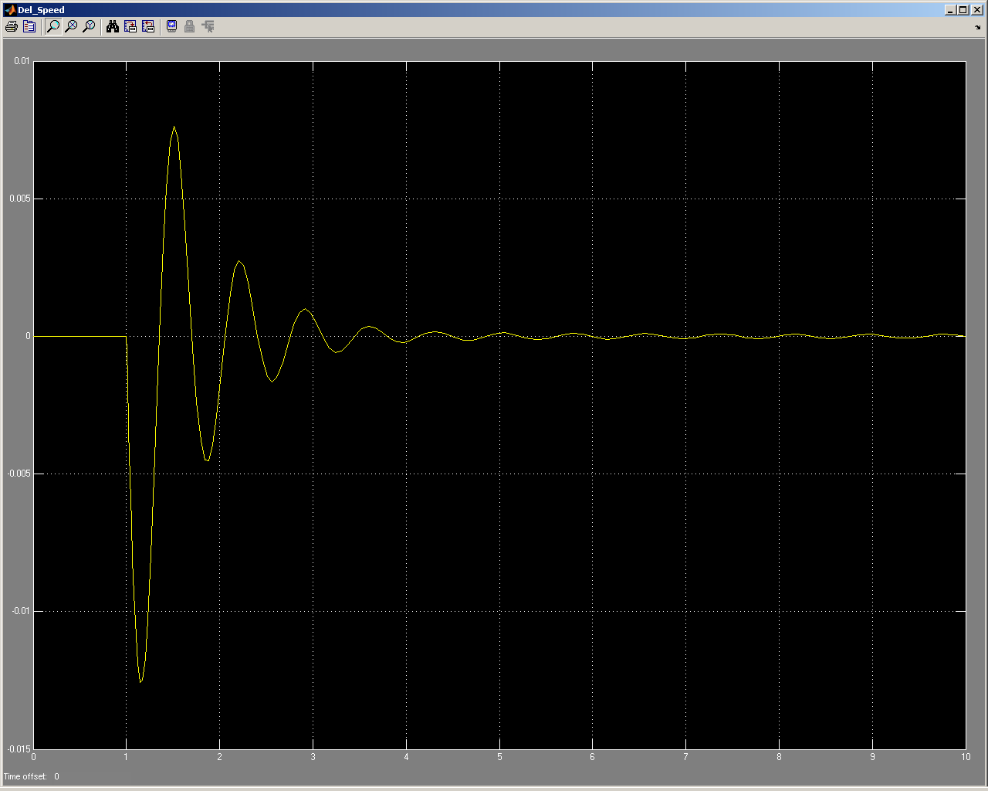
Generator Frequency Response to Load Change
This plot is for the frequency deviation of a generator with a speed governor.
Unlike the classical model, frequency returns to nominal after the disturbance.
This is the type of control that is necessary in a micro-grid.

Slide 75
Multiple Machines
Normally generators are designed to operate either independently or in an interconnected system.
Independent: The generator is the only source of power and as such it actively regulates the frequency and voltage.
Interconnected System: The generator outputs power according to a dispatch, it may be part of automatic generation control if it is large enough.
In a micro-grid it is common to find multiple generating units without a central control system, each generator is its own open loop controller.
The best way to handle the coordination of multiple open loop control systems is through the use of droop characteristics.

Slide 76
Droop Curves
The characteristic of interested is regulated to a lower level as the amount of load increases.

Slide 77
Droop Curve
As the load on the generator increases, the frequency decreases slightly.
The change in frequency is very small <.1 Hz.
For a single generator operating in isolation a droop characteristic is not necessary.
But for generators operating in parallel it is necessary.

Slide 78
Droop Curve
In the figure there are two generators with the electrical load shown by the dashed line.
The slope of the two droop curves decide which generator picks up what percentage of the load.
The house curves can be moved up or down to change load, and frequency.
In this way the load is properly distributed among the generators and there are not oscillations between regulators.
The same principles can be used on the voltage regulators.

Slide 79
Voltage Control
If there is a microgrid with a single generator then voltage control is achieved in the traditionally manner.
The voltage regulator on the generator sets the voltage and any regulators or capacitors assist.
A voltage regulator on a generator adjusts the field excitation on the rotor, with response times of well below 1 second.
Because regulators and capacitors have time delays and require the operation of physical switches they will respond much slower than the voltage regulator on the generator.
If more than one generator exists on the micro-grid then it is necessary to coordinate their voltage control.
Droop curves similar to those used for frequency control can be used.
For frequency control the droop curves apply to the governors, and for voltage control the droop curve is applied to the voltage regulator.

Slide 80
Power/Energy management objectives
Connected mode:
Specify DER power output for specific objective (e.g. peak shaving, maximize renewables, minimize fuel costs)
Consider limitations of DERs
Main grid to provide difference
Manage settings of DER in preparation to transition to isolated mode
Isolated mode:
Power balance to be met by microgrid resources (no main grid contribution)
Provide power to sensitive loads, use non-sensitive load to help balance the microgrid
Enable reconnection to main grid after restoration

Slide 81
Central Control
…

Slide 82
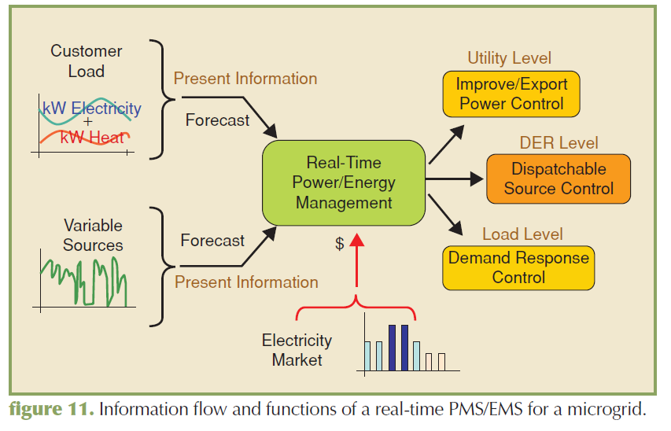
Power/energy management
F. Katiraei et al, “Microgrids management,” IEEE Power & Energy Magazine, May/June 2008

Slide 83
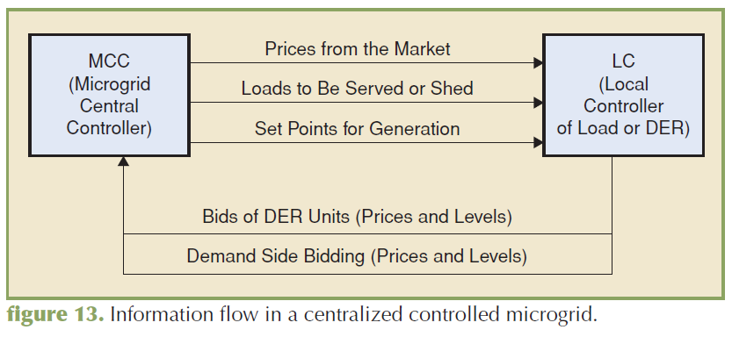
Microgrid central controller
F. Katiraei et al, “Microgrids management,” IEEE Power & Energy Magazine, May/June 2008

Slide 84
Hierarchical Control
…

Slide 85
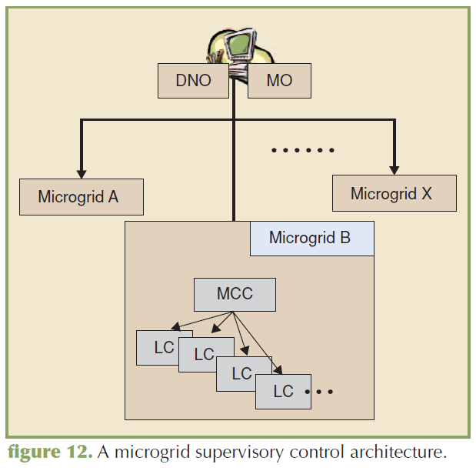
Hierarchical architecture for microgrids
Distribution network operator (DNO)
Market operator (MO)
Microgrid central controller (MCC)
Local controllers associated with individual DER
F. Katiraei et al, “Microgrids management,” IEEE Power & Energy Magazine, May/June 2008

Slide 86
Decentralized Control
…

Slide 87
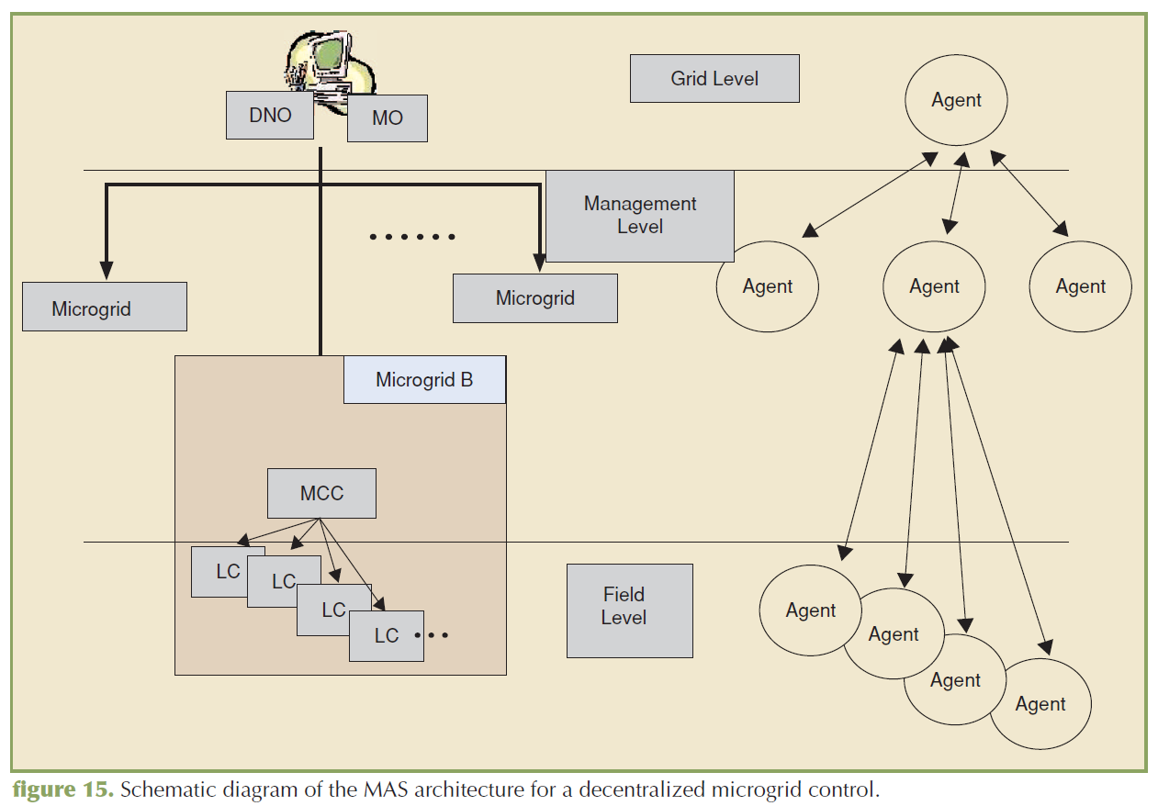
Decentralized coordination of microgrids
F. Katiraei et al, “Microgrids management,” IEEE Power & Energy Magazine, May/June 2008

Slide 88
Protection System for Micro-Grids
Transition between interconnected and islanded mode
Short circuit capacity significantly changes between interconnected and islanded mode. Change in protection settings and logics may be needed.
Fault detection may become an issue because low fault current contribution from power electronic based DERs
Protection coordination should be prepared for bi-directional fault current contributions
Redefinition of anti-islanding protection
In microgrid anti-islanding protection that shuts down DER is not convenient
Islanding detection relays can be used to trigger transition between grid connected and islanded operation method

Slide 89
Module 10 Concluding Comments
1
2
3
4

